Slide 1
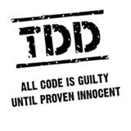
Test Driving .NET
Keith Burnell
Senior Software Engineer
Email: keith@dotnetdevdude.com
Twitter: keburnell
Blog: www.DotNetDevDude.com

Slide 2
Little about me
Senior Software Engineer at Skyline Technologies, a Microsoft Gold Partner.
Been developing software for ~15 years
Primary focus on the Microsoft stack.
Spend majority of time developing Web *stuff*.
Consulting for last 10 years.
Vice President of Fox Valley .NET UG.
INETA Speaker.
Blogger (DotNetDevDude.com)
Twitterer (@keburnell)
@keburnell ∙ DotNetDevDude.com
Notes:
Scrum most popular.

Slide 3
What’s on Tap
Do you need to be doing Test-driven Development?
Types of testing
What is Test-driven development?
Unit Testing
Concepts and strategies you need to know
Laying out your solution for maximum testability
Dependency Injection and Inversion of Control
Mocks, Fakes, Stubs
DI/IoC Tooling
@keburnell ∙ DotNetDevDude.com
Notes:
Scrum most popular.

Slide 4
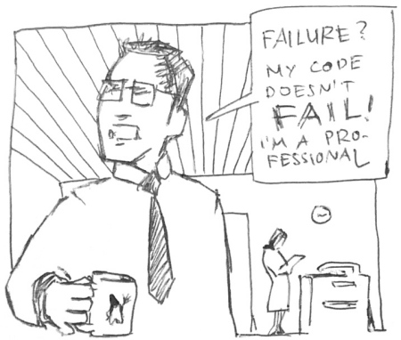
Do I Really Need To Be Doing Test-driven Development?
@keburnell ∙ DotNetDevDude.com
Notes:
Scrum most popular.

Slide 5

@keburnell ∙ DotNetDevDude.com
Notes:
Scrum most popular.

Slide 6
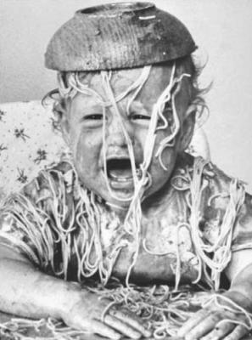
Ever have to deal with Spaghetti Code?
@keburnell ∙ DotNetDevDude.com
Notes:
Scrum most popular.

Slide 7
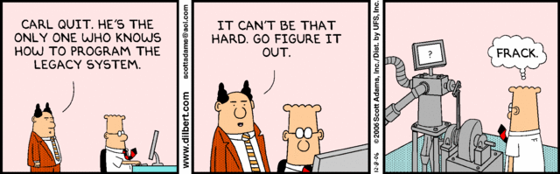
Ever inherit Legacy Code?
@keburnell ∙ DotNetDevDude.com
Notes:
Scrum most popular.

Slide 8

Ever scared to make changes?
@keburnell ∙ DotNetDevDude.com
Notes:
Scrum most popular.

Slide 9

If you answered yes to any of those questions
Then…
@keburnell ∙ DotNetDevDude.com
Notes:
Scrum most popular.

Slide 10

@keburnell ∙ DotNetDevDude.com
Notes:
Scrum most popular.

Slide 11
Types of testing that are not keys to test-driven development
@keburnell ∙ DotNetDevDude.com
Notes:
Scrum most popular.

Slide 12

Integration Testing
@keburnell ∙ DotNetDevDude.com
Notes:
Scrum most popular.

Slide 13
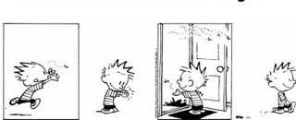
Regression Testing
@keburnell ∙ DotNetDevDude.com
Notes:
Scrum most popular.

Slide 14
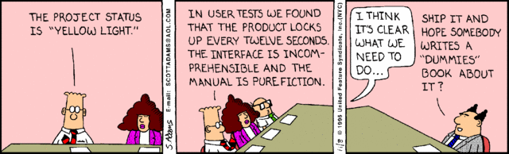
User Acceptance Testing (UAT)
@keburnell ∙ DotNetDevDude.com
Notes:
Scrum most popular.

Slide 15

Performance Testing
@keburnell ∙ DotNetDevDude.com
Notes:
Scrum most popular.

Slide 16

Load Testing
@keburnell ∙ DotNetDevDude.com
Notes:
Scrum most popular.

Slide 17
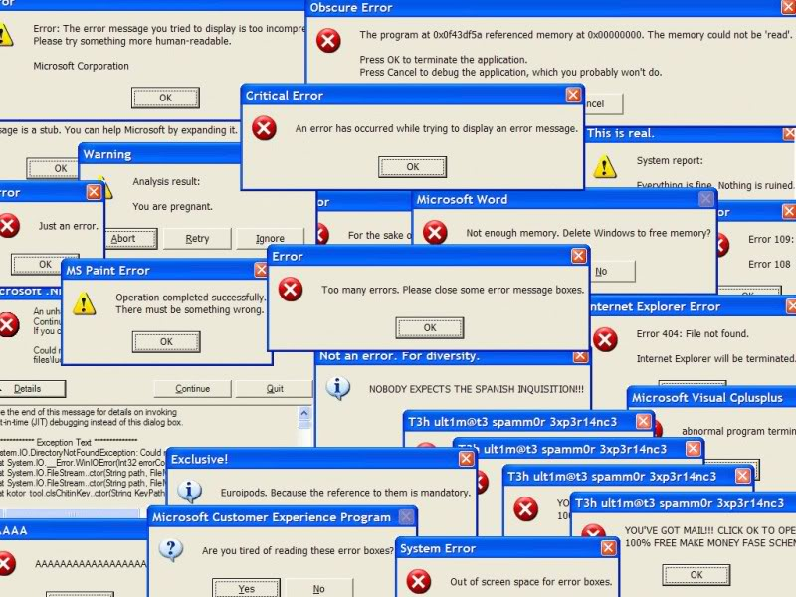
Stress Testing
@keburnell ∙ DotNetDevDude.com
Notes:
Scrum most popular.

Slide 18
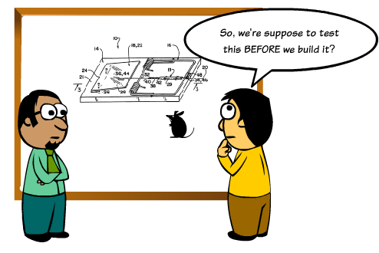
What is Test-driven Development?
@keburnell ∙ DotNetDevDude.com
Notes:
Scrum most popular.

Slide 19
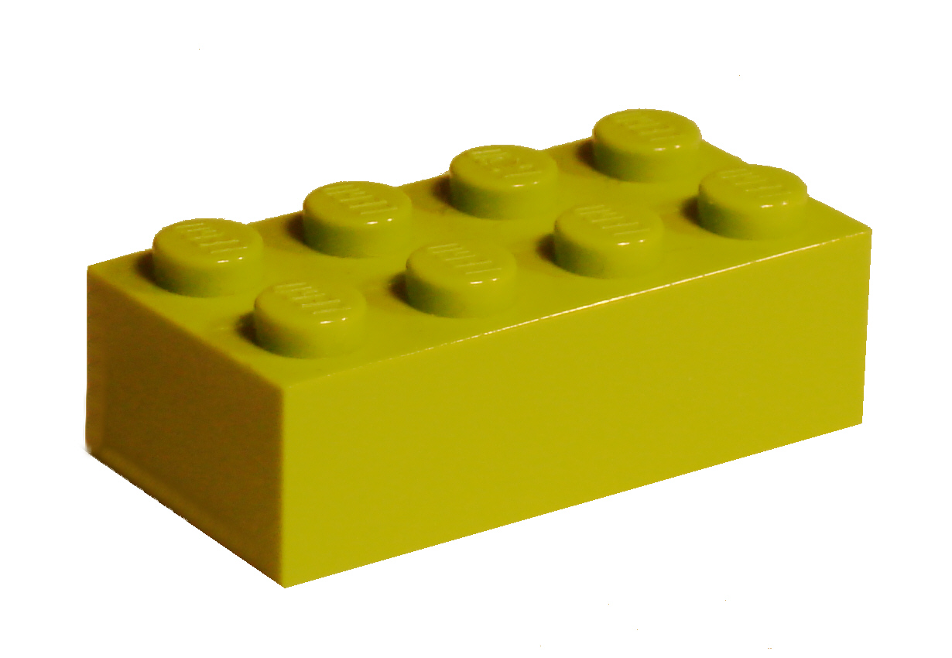
Unit Testing: Key to TDD
@keburnell ∙ DotNetDevDude.com
Notes:
Scrum most popular.

Slide 20

What makes a good Unit Test?
@keburnell ∙ DotNetDevDude.com
Notes:
Scrum most popular.

Slide 21

Automated and Repeatable
@keburnell ∙ DotNetDevDude.com
Notes:
Scrum most popular.

Slide 22
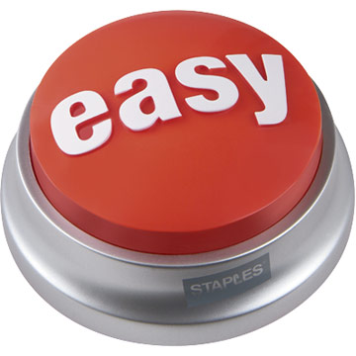
Easy to implement
@keburnell ∙ DotNetDevDude.com
Notes:
Scrum most popular.

Slide 23

Run on Demand at the Push of a Button
@keburnell ∙ DotNetDevDude.com
Notes:
Scrum most popular.

Slide 24

Fast
@keburnell ∙ DotNetDevDude.com
Notes:
Scrum most popular.

Slide 25

Isolated
@keburnell ∙ DotNetDevDude.com
Notes:
Scrum most popular.

Slide 26
Important Concepts & Strategies
@keburnell ∙ DotNetDevDude.com
Notes:
Scrum most popular.

Slide 27
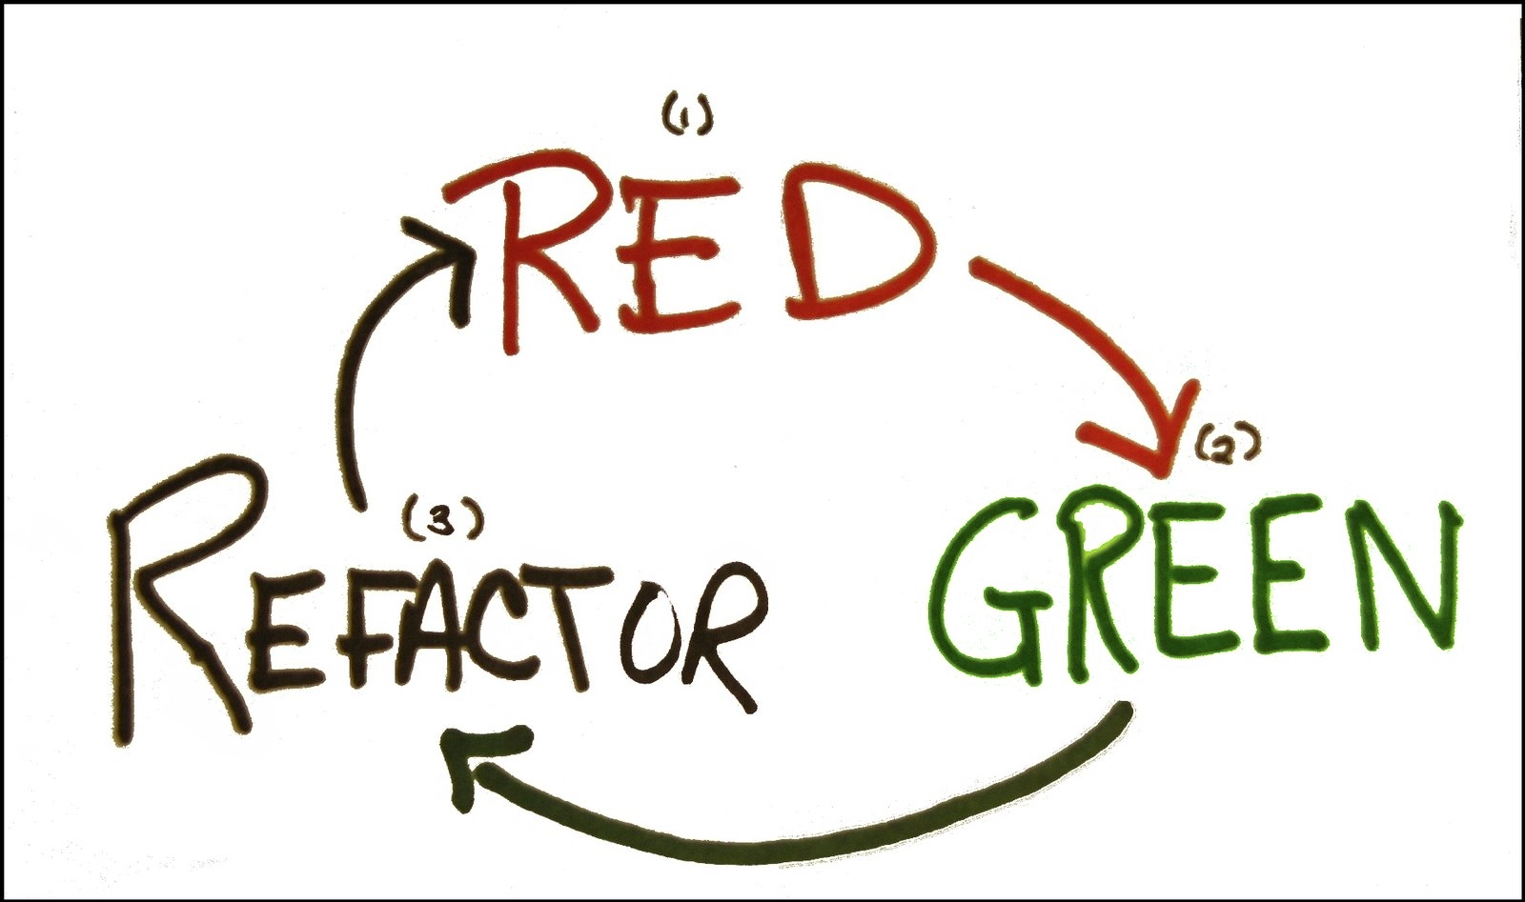
@keburnell ∙ DotNetDevDude.com
Notes:
Scrum most popular.

Slide 28

Arrange – Act - Assert
@keburnell ∙ DotNetDevDude.com
Notes:
Scrum most popular.

Slide 29
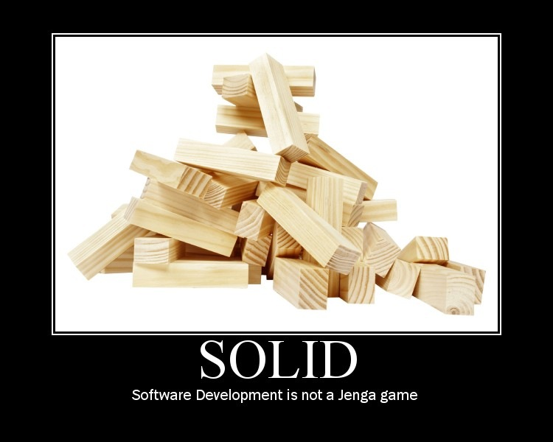
SOLID Principles of Software Development
@keburnell ∙ DotNetDevDude.com
Notes:
Scrum most popular.

Slide 30

Single Responsibility Principle
@keburnell ∙ DotNetDevDude.com
Notes:
Scrum most popular.

Slide 31

Open Closed Principle
@keburnell ∙ DotNetDevDude.com
Notes:
Scrum most popular.

Slide 32
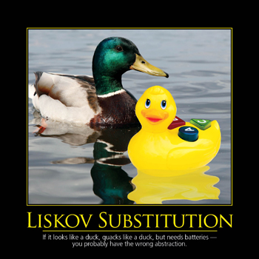
Liskov Substitution Principle
@keburnell ∙ DotNetDevDude.com
Notes:
Scrum most popular.

Slide 33

Interface Segregation Principle
@keburnell ∙ DotNetDevDude.com
Notes:
Scrum most popular.

Slide 34

Dependency Inversion Principle
@keburnell ∙ DotNetDevDude.com
Notes:
Scrum most popular.

Slide 35

Laying Out Your Solution For Unit Testing
@keburnell ∙ DotNetDevDude.com
Notes:
Scrum most popular.

Slide 36
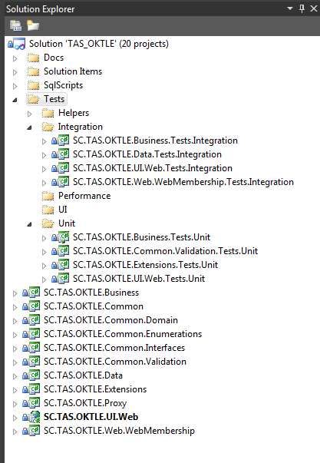
Example Solution Layout
@keburnell ∙ DotNetDevDude.com
Notes:
Scrum most popular.

Slide 37
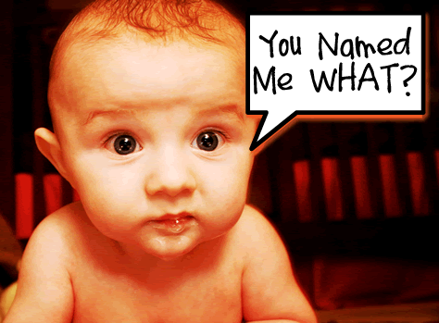
Naming Your Tests
@keburnell ∙ DotNetDevDude.com
Notes:
Scrum most popular.

Slide 38
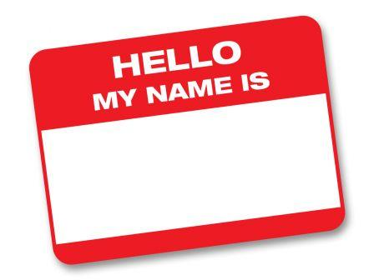
How I Name My Tests
[MethodUnderTest]_[ExpectedResult]_[Conditions]
GetCustomers_ShouldReturn_ListOf_Customers()
CalculateRate_ShouldReturn_25_When_Interest_Is_50_And_X_Is_5()
@keburnell ∙ DotNetDevDude.com
Notes:
Scrum most popular.

Slide 39
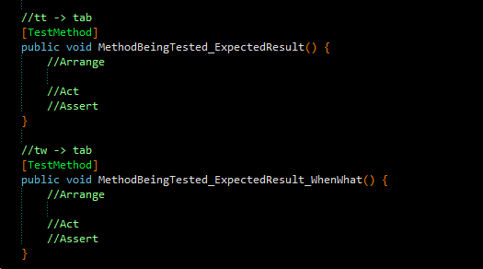
Resharper Live Template for Naming Tests
My unit testing live template is available on my blog:
http://www.dotnetdevdude.com/downloads/code/ ResharperUnitTestTemplates.zip
@keburnell ∙ DotNetDevDude.com
Notes:
Scrum most popular.

Slide 40

Let’s Write Our First Unit Test - Together!
@keburnell ∙ DotNetDevDude.com
Notes:
Scrum most popular.

Slide 41
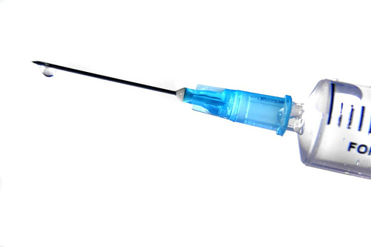
Dependency Injection (DI)
@keburnell ∙ DotNetDevDude.com
Notes:
Scrum most popular.

Slide 42

Inversion of Control (IoC)
@keburnell ∙ DotNetDevDude.com
Notes:
Scrum most popular.

Slide 43

Non-programming Example of IoC
Simple Scenario: Your having a bathroom remodeled
Remodel Bathroom: $10,000.00
@keburnell ∙ DotNetDevDude.com
Notes:
Scrum most popular.

Slide 44

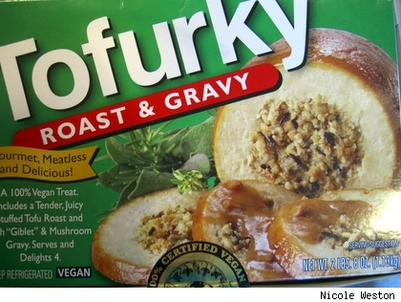
What does implementing DI/IoC get me?
Separation of Concerns
Mockability (we will get to this)
@keburnell ∙ DotNetDevDude.com
Notes:
Scrum most popular.

Slide 45
Let’s Do Some DI/IoC - Together!
@keburnell ∙ DotNetDevDude.com
Notes:
Scrum most popular.

Slide 46

Ruh roh! Test is broken!
@keburnell ∙ DotNetDevDude.com
Notes:
Scrum most popular.

Slide 47
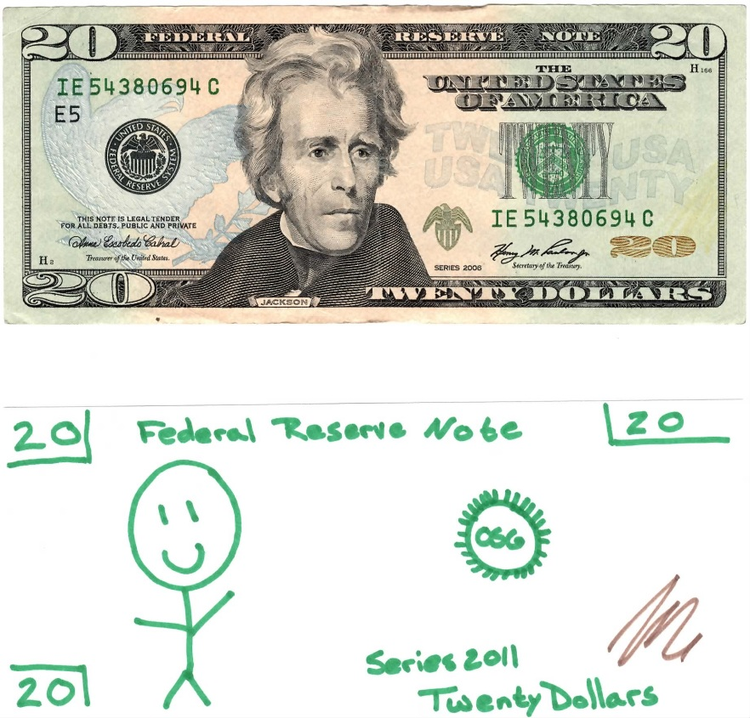
Fakes/Stubs
@keburnell ∙ DotNetDevDude.com
Notes:
Scrum most popular.

Slide 48

Mocks
@keburnell ∙ DotNetDevDude.com
Notes:
Scrum most popular.

Slide 49

Dependency Injection 101
@keburnell ∙ DotNetDevDude.com
Notes:
Scrum most popular.

Slide 50

DI/IoC Tooling
@keburnell ∙ DotNetDevDude.com
Notes:
Scrum most popular.

Slide 51
Lots of Available Tooling
For a list of the most common and a sample application that implements each one check a blog post I did;
http://bit.ly/hnIjlu
@keburnell ∙ DotNetDevDude.com
Notes:
Scrum most popular.

Slide 52
Let’s Implement DI/IoC with Tooling - Together!
@keburnell ∙ DotNetDevDude.com
Notes:
Scrum most popular.

Slide 53

Slides, Code, and Notes On GitHub
http://www.github.com/kburnell/TestDriving.NET
@keburnell ∙ DotNetDevDude.com
Notes:
Scrum most popular.

Slide 54
Other Resources
Test Driven Development: By Example (Kent Beck)
The Art of Unit Testing (Roy Osherove)
Roy Osherove’s Blog (http://www.osherove.com)
TypeMock’s website (http://www.typemock.com)
My Website (http://www.dotnetdevdude.com)
@keburnell ∙ DotNetDevDude.com
Notes:
Scrum most popular.

Slide 55
Tools I Used and/or Talked About
NuGet (http://www.nuget.org)
ReSharper (http://www.jetbrains.com/resharper/)
Should Assertion Library (http://should.codeplex.com)
NCrunch (http://www.ncrunch.net)
RhinoMocks (http://hibernatingrhinos.com/open-source/rhino-mocks
StructureMap (http://www.structuremap.net)
@keburnell ∙ DotNetDevDude.com
Notes:
Scrum most popular.

Slide 56
Friday April 27th (all day)
Radisson Paper Valley Hotel (Appleton, WI)
Led by Clark Sell and Brian Prince
Hands on deep dive
Free
Lunch will be provided
Bring your own hardware
Register Now!
http://www.BootCamp.fvnug.org
@keburnell ∙ DotNetDevDude.com
Notes:
Scrum most popular.

Slide 57
Saturday April 28th (8:00 – 4:30)
Fox Valley Tech Commons area
Great speakers and content
Free
Lunch will be provided
Lots of Swag!
All attendees will get a free eBook from O’Reilly
Register Now!
http://www.DayOfDotNet.fvnug.org
@keburnell ∙ DotNetDevDude.com
Notes:
Scrum most popular.

Slide 58

@keburnell ∙ DotNetDevDude.com
Notes:
Scrum most popular.

Slide 59
Thank You!
Questions?
Twitter: @keburnell
Blog: DotNetDevDude.com
Email: keith@DotNetDevDude.com
@keburnell ∙ DotNetDevDude.com
Notes:
Scrum most popular.

